Slide 1
Example
Tuna Age

Slide 2
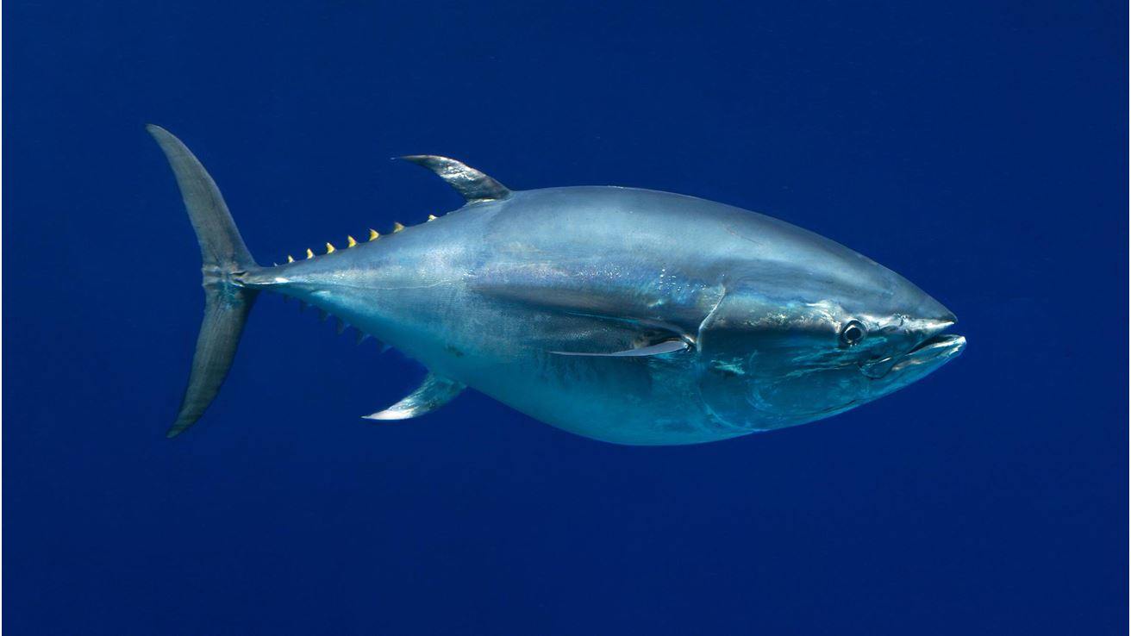

Slide 3
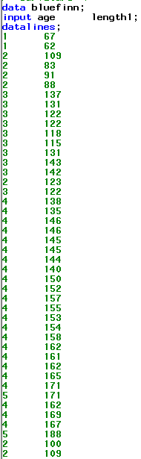
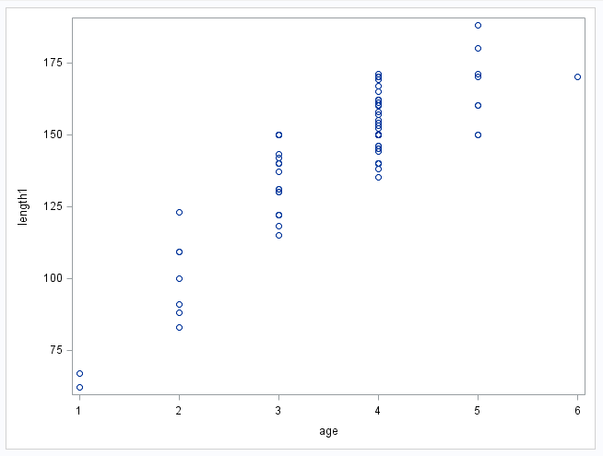
Quadratic Regression
Beautiful look at no evidence against normally distributed data per age
Also great look at constant standard deviation per age

Slide 4
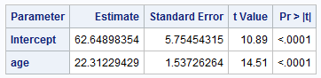
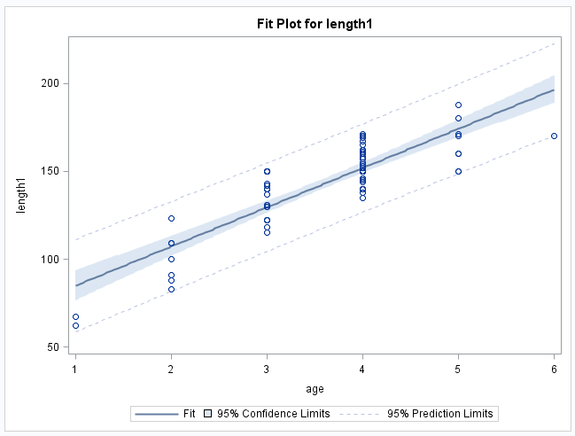
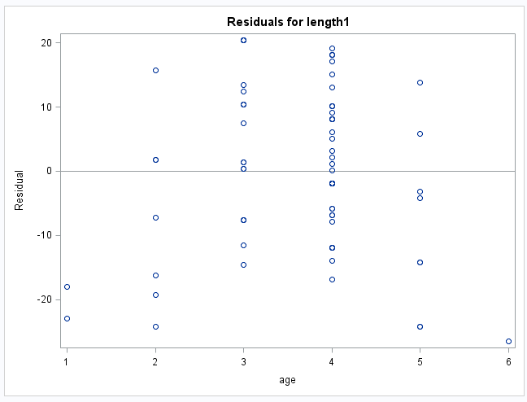
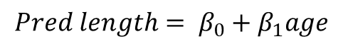
Simple Linear Fit
$$Pred length= β_{0}+β_{1}age$$
The assumptions are not fully met (linear trend between age and the mean of length). There appears to be some evidence of a curved trend both in the scatter plot of the data and in the residuals. We can still use “linear” regression, however … we just need to transform age.

Slide 5
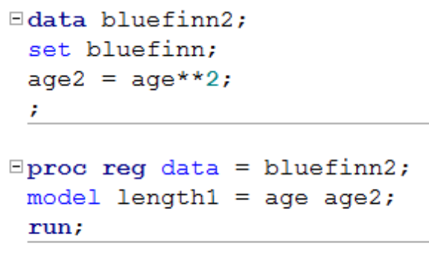
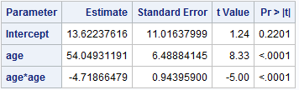
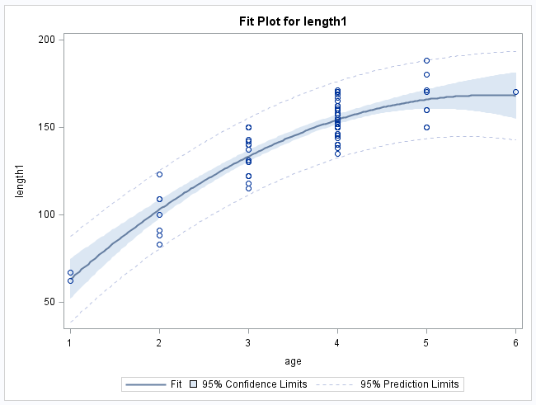
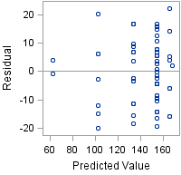
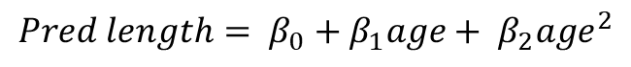
Quadratic Regression
$$Pred length= β_{0}+β_{1}age+ β_{2}{age}^{2}$$

Slide 6
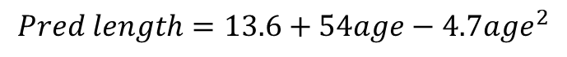
Quadratic Regression (cont.)
$$Pred length=13.6+54age−4.7{age}^{2}$$
Interpretation of coefficients is difficult. Quadratic terms are used mostly when the QOI is focused on prediction.

Slide 7
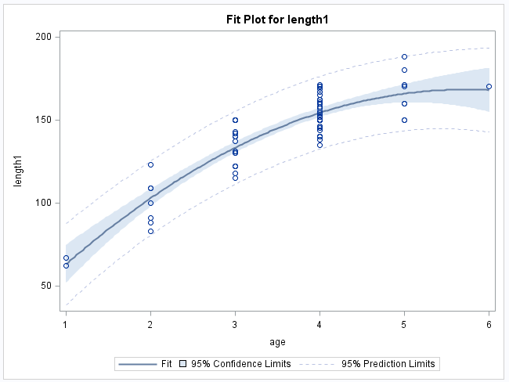
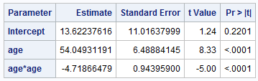
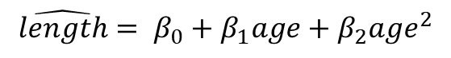
Quadratic Regression: Maximums
Can you find the estimated age at which the tuna’s tail is at its maximum?
$$\hat{length}= β_{0}+β_{1}age+β_{2}{age}^{2}$$
PArabola!

Slide 8
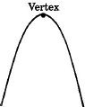
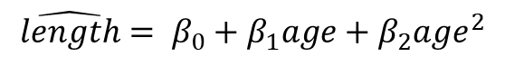
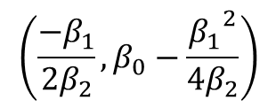
Dream Sequence
$$\hat{length}= β_{0}+β_{1}age+β_{2}{age}^{2}$$
Algebra II
$$\left(\frac{−β_{1}}{2β_{2}},β_{0}−\frac{{β_{1}}^{2}}{4β_{2}}\right)$$

Slide 9
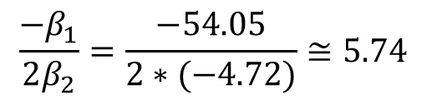
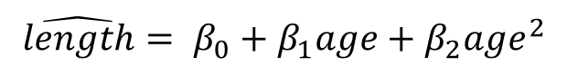
Quadratic Regression: Maximums
Can you find the estimated age at which the tuna’s tail is at its maximum?
$$\hat{length}= β_{0}+β_{1}age+β_{2}{age}^{2}$$
Parabola!
$$\frac{−β_{1}}{2β_{2}}=\frac{−54.05}{2∗(−4.72)}≅5.74$$
The evidence suggests that the mean age at which a tuna’s tail stops growing is approximately 5.74 years based on a quadratic regression model (p-value < .0001).

Slide 10
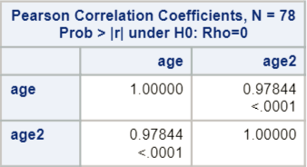
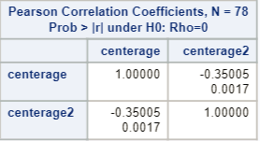
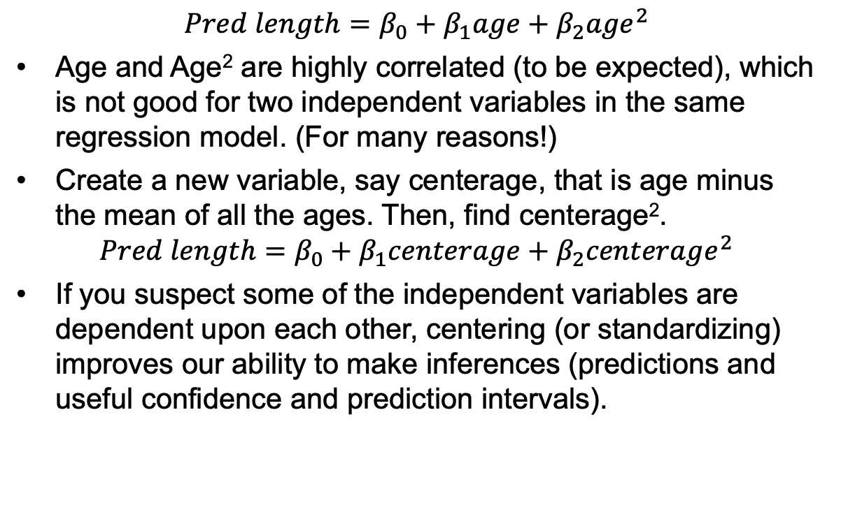
Example: Bluefin Tuna Re-centering Method
$$Pred length=β_{0}+β_{1}age+β_{2}{age}^{2}$$
Age and Age² are highly correlated (to be expected), which is not good for two independent variables in the same regression model. (For many reasons!)
Create a new variable, say centerage, that is age minus the mean of all the ages. Then, find centerage².
$$Pred length=β_{0}+β_{1}centerage+β_{2}{centerage}^{2}$$
If you suspect some of the independent variables are dependent upon each other, centering (or standardizing) improves our ability to make inferences (predictions and useful confidence and prediction intervals).

Slide 12
Overfitting

Slide 13
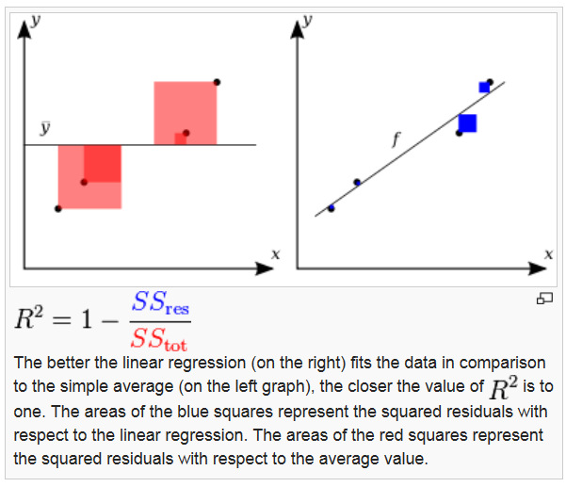
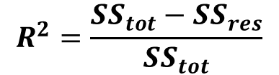
R²
$$R^{2}=\frac{{SS}_{tot}−{SS}_{res}}{{SS}_{tot}}$$

Slide 14
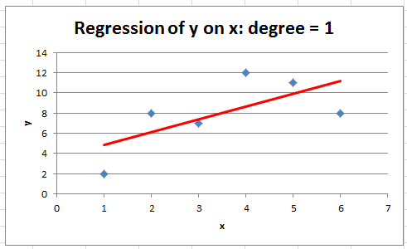
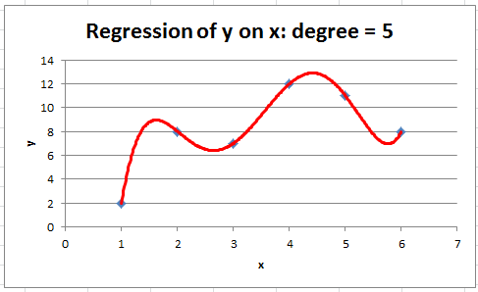
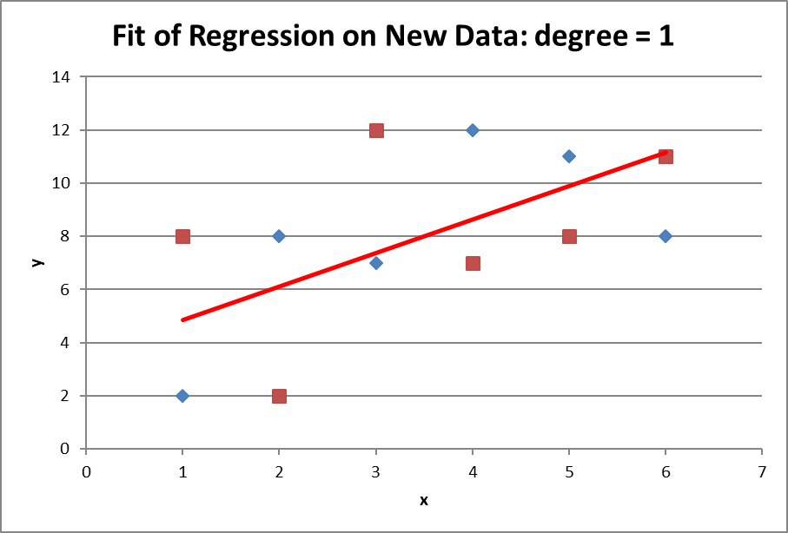
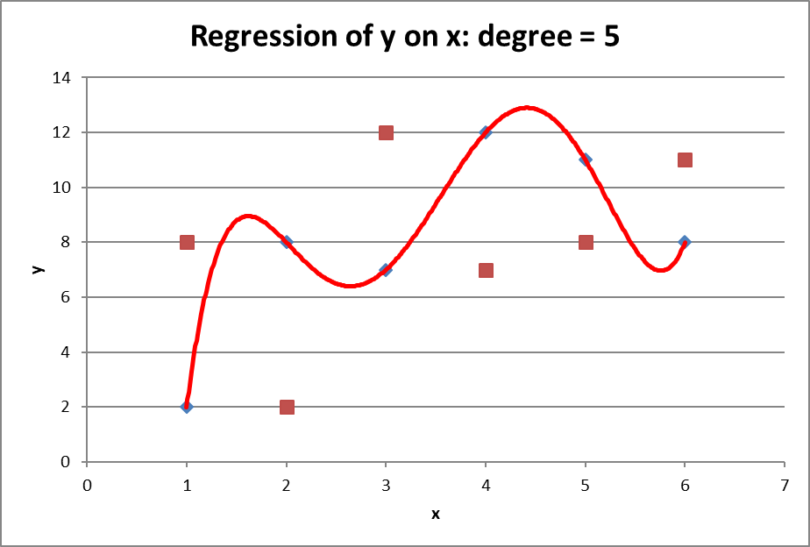
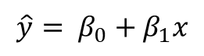
R² Can Always Be Made to Be 100% by Adding Explanatory Variables
R² is a statistic that indicates how well a model fits the sample data. It is not an indicator of how well the model will fit a new sample from the same population.
$$\hat{y}= β_{0}+β_{1}x$$
$$\hat{y}= β_{0}+β_{1}x+β_{2}x^{2}+β_{3}x^{3}+β_{4}x^{4}+β_{5}x^{5}$$
R² = .4461
R² = 1
SS_{res} = 0
SS_{res} = 34.3
SS_{res} = 54.5
SS_{res} = 140

Slide 16
Adjusted R²

Slide 17
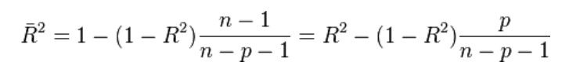
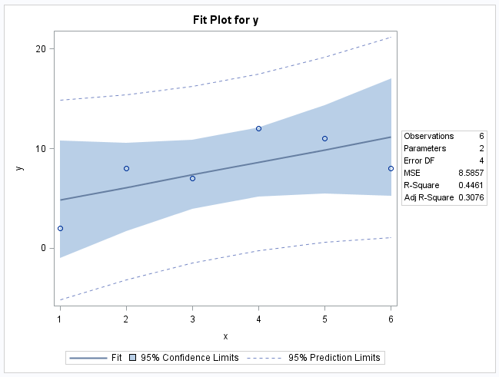
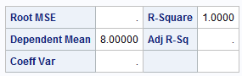
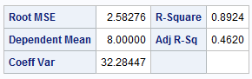
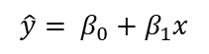
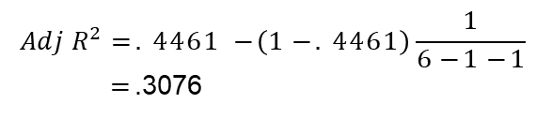
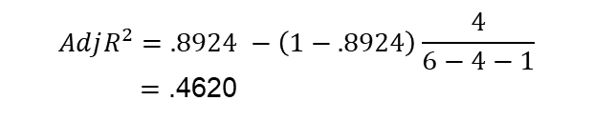
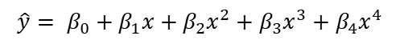
Adjusted R²
P = number of predictor variables.
$$\hat{y}= β_{0}+β_{1}x$$
$$\hat{y}= β_{0}+β_{1}x+β_{2}x^{2}+β_{3}x^{3}+β_{4}x^{4}+β_{5}x^{5}$$
$$\hat{y}= β_{0}+β_{1}x+β_{2}x^{2}+β_{3}x^{3}+β_{4}x^{4}$$
$$AdjR^{2}=.4461 −\left(1−.4461\right)\frac{1}{6−1−1}$$
$=$ .3076
$$AdjR^{2}=.8924 −\left(1−.8924\right)\frac{4}{6−4−1}$$
$=$ .4620

Slide 18
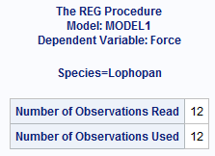
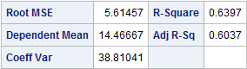
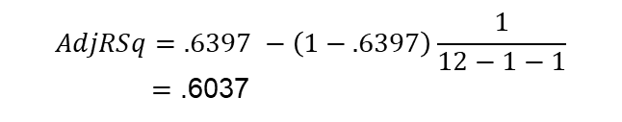
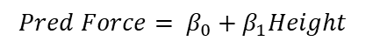
Practice Problem!
Calculate the adjusted R² for the following model:
$$Pred Force= β_{0}+β_{1}Height$$
P = number of predictor variables.
$$AdjRSq=.6397 −\left(1−.6397\right)\frac{1}{12−1−1}$$
$=$ .6037

Slide 19
Quadratic Regression
$$Pred length= β_{0}+β_{1}age+ β_{2}{age}^{2}$$

Slide 20
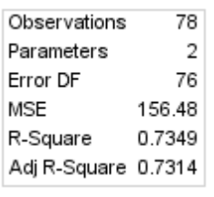
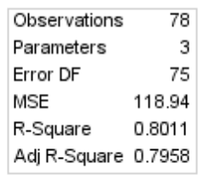
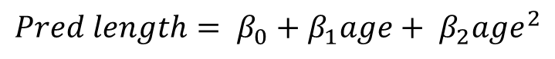
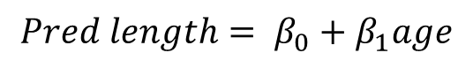
Comparing with Adjusted R²
$$Pred length= β_{0}+β_{1}age$$
$$Pred length= β_{0}+β_{1}age+ β_{2}{age}^{2}$$
The adjusted R² statistic favors the quadratic model despite the penalty for more predictors.

Slide 21
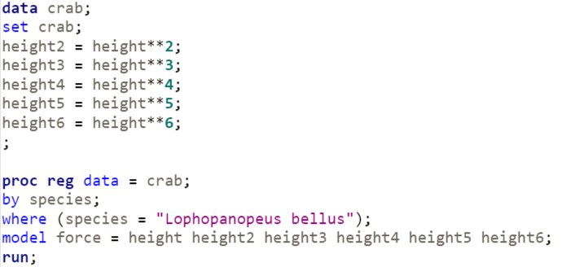
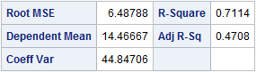
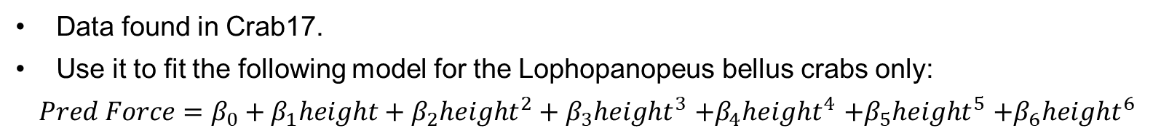
Practice Problem
Data found in Crab17.
Use it to fit the following model for the Lophopanopeus bellus crabs only:
$Pred Force=β_{0}+β_{1}height+β_{2}{height}^{2}+β_{3}{height}^{3}$ $+β_{4}{height}^{4}$ $+β_{5}{height}^{5}$ $+β_{6}{height}^{6}$
SAS hint:
X² = x**2
X³ = X**3
etc.
Report the R² and the adjusted R²

Slide 22
Concept Check 13.5.5: Add Meadowfoam and Charity example for adjusted R²
Live Session?: Maybe even calculate adjusted R² from Unit 12: Salary Example of Professors

Slide 24
“Controlling” for Other Variables in the Model

Slide 25



$$Pred log\left(life\right)=3.72−0.316log⁡(metab)+0.535log⁡(mass)$$
2.9
3.1
0.5
1.1
*Black is the log Metabolism value

Slide 27
Example
Echolocation and Bats Introduction

Slide 28
Echolocation!
QOI: Is there a difference in the in-flight energy expenditures among all three animals after body size is accounted for? Explore the possibility of unequal slopes.
In order to answer this question, it will help first to test if all the regression lines are parallel (if the slopes are equal). If they are, then we can check for a difference in energy expenditure across all body sizes simultaneously by looking at the intercept. See Display 10.5 on page 276.
$$μ\left\{lenergy \right|lmass, TYPE\}= β_{0}{+β}_{1}lmass{+β}_{2}bird{+β}_{3}ebat{+β}_{4}lmass∗bird{+β}_{5} lmass ∗ebat$$
Indicator variables for the variable TYPE
Which of the three types of animals (bird, ebat, or nebat) is the reference type in this model?
Nebat
It occurs when ebat = 0 and bird = 0.

Slide 29

Echolocation!
QOI: Is there a difference in the in-flight energy expenditures among all three animals after body size is accounted for? Explore the possibility of unequal slopes.
In order to answer this question, it will help first to test if all the regression lines are parallel (if the slopes are equal). If they are, then we can check for a difference in energy expenditure across all body sizes simultaneously by looking at the intercept. See Display 10.5 on page 276.
$$μ\left\{lenergy \right|lmass, TYPE\}= β_{0}{+β}_{1}lmass{+β}_{2}bird{+β}_{3}ebat$$

Slide 30


Where to Find Adjusted R² in PROC GLM
$$μ\left\{lenergy \right|lmass, TYPE\}= β_{0}{+β}_{1}lmass{+β}_{2}bird{+β}_{3}ebat{+β}_{4}lmass∗bird{+β}_{5} lmass ∗ebat$$

Slide 31





Back to Bat Echolocation Problem
$$H0:β_{4}=β_{5}=0$$
$$Ha:β_{4} and β_{5} are not both 0$$
$$μ\left\{lenergy \right|lmass, TYPE\}= β_{0}{+β}_{1}lmass{+β}_{2}bird{+β}_{3}ebat{+β}_{4}lmass∗bird{+β}_{5} lmass ∗ebat$$
Full Model
$$μ\left\{lenergy \right|lmass, TYPE\}= β_{0}{+β}_{1}lmass{+β}_{2}bird{+β}_{3}ebat$$
Reduced Model
The adjusted R² favors the model without the interaction parameters.

Slide 33
Example Bat Echolocation
Extra Sum of Squares Test

Slide 34
Echolocation! Part I
QOI: Is there a difference in the in-flight energy expenditures between echolocating and non echolocating bats after body size is accounted for? Explore the possibility of unequal slopes.
In order to answer this question, it will help first to test if all the regression lines are parallel (if the slopes are equal). If they are, then we can check for a difference in energy expenditure across all body sizes simultaneously. See Display 10.5 on page 276.
$$μ\left\{lenergy \right|lmass, TYPE\}= β_{0}{+β}_{1}lmass{+β}_{2}bird{+β}_{3}ebat{+β}_{4}lmass∗bird{+β}_{5} lmass ∗ebat$$

Slide 35
Echolocation!
QOI: Is there a difference in the in-flight energy expenditures among all three animals after body size is accounted for? Explore the possibility of unequal slopes.
In order to answer this question, it will help first to test if all the regression lines are parallel (if the slopes are equal). If they are, then we can check for a difference in energy expenditure across all body sizes simultaneously by looking at the intercept. See Display 10.5 on page 276.
$$μ\left\{lenergy \right|lmass, TYPE\}= β_{0}{+β}_{1}lmass{+β}_{2}bird{+β}_{3}ebat{+β}_{4}lmass∗bird{+β}_{5} lmass ∗ebat$$
Indicator variables for the variable TYPE
Which of the three types of animals (bird, ebat, or nebat) is the reference type in this model?
Nebat
It occurs when ebat = 0 and bird = 0.

Slide 36



Echolocation! Part II
$$μ\left\{lenergy \right|lmass, TYPE\}= β_{0}{+β}_{1}lmass{+β}_{2}bird{+β}_{3}ebat{+β}_{4}lmass∗bird{+β}_{5} lmass ∗ebat$$
Individual regression equations for each value of TYPE:
Type = ebat occurs when ebat = 1 and bird = 0.
$$μ\left\{lenergy \right|lmass, TYPE=ebat\}= β_{0}{+β}_{1}lmass{+β}_{2}∗0{+β}_{3}∗1{+β}_{4}lmass∗0{+β}_{5} lmass ∗1$$
$$μ\left\{lenergy \right|lmass, TYPE=ebat\}= β_{0}{+β}_{1}lmass{+β}_{3}{+β}_{5} lmass$$
0
0
$$μ\left\{lenergy \right|lmass, TYPE=ebat\}= β_{0}{+β}_{3}{+β}_{1}lmass{+β}_{5} lmass$$
$μ\left\{lenergy \right|lmass, TYPE=ebat\}=\left(β_{0}{+β}_{3}\right)+(β_{1}{+β}_{5})lmass$: slope = $β_{1}{+β}_{5}$
Type = bird occurs when ebat = 0 and bird = 1.
$$μ\left\{lenergy \right|lmass, TYPE=bird\}= β_{0}{+β}_{1}lmass{+β}_{2}∗1{+β}_{3}∗0{+β}_{4}lmass∗1{+β}_{5} lmass ∗0$$
$$μ\left\{lenergy \right|lmass, TYPE=bird\}= β_{0}{+β}_{1}lmass{+β}_{2}{+β}_{4} lmass$$
0
0
$$μ\left\{lenergy \right|lmass, TYPE=bird\}= β_{0}{+β}_{2}{+β}_{1}lmass{+β}_{4} lmass$$
$μ\left\{lenergy \right|lmass, TYPE=bird\}=\left(β_{0}{+β}_{2}\right)+(β_{1}{+β}_{4})lmass$: slope = $β_{1}{+β}_{4}$
What is the regression equation for nebat (and slope)?
Type = nebat occurs when ebat = 0 and bird = 0.
$$μ\left\{lenergy \right|lmass, TYPE=nebat\}=β_{0}{+β}_{1}lmass{+β}_{2}∗0{+β}_{3}∗0{+β}_{4}lmass∗0{+β}_{5} lmass ∗0$$
$μ\left\{lenergy \right|lmass, TYPE=nebat\}=β_{0}+β_{1}lmass$: slope = $β_{1}$
0
0
0
0

Slide 37



Echolocation! Part II
$$μ\left\{lenergy \right|lmass, TYPE\}= β_{0}{+β}_{1}lmass{+β}_{2}bird{+β}_{3}ebat{+β}_{4}lmass∗bird{+β}_{5} lmass ∗ebat$$
$$μ\left\{lenergy \right|lmass, TYPE\}= β_{0}{+ β}_{2}bird{+β}_{3}ebat{+ β}_{1}lmass{+ β}_{4}lmass∗bird{+β}_{5} lmass ∗ebat$$
$μ\left\{lenergy \right|lmass, TYPE\}= {(β}_{0}{+ β}_{2}bird{+β}_{3}ebat){+ (β}_{1}{+ β}_{4}∗bird{+β}_{5} ∗ebat)$ $lmass$
Individual regression equations for each value of TYPE:
Type = ebat occurs when ebat = 1 and bird = 0.
$μ\left\{lenergy \right|lmass, TYPE\}= {(β}_{0}{+ β}_{2}bird{+β}_{3}ebat){+ (β}_{1}{+ β}_{4}∗bird{+β}_{5} ∗ebat)$ $lmass$
$μ\left\{lenergy \right|lmass, TYPE=ebat\}=\left(β_{0}{+β}_{3}\right)+(β_{1}{+β}_{5})lmass$: slope = $β_{1}{+β}_{5}$
0
0
Type = bird occurs when ebat = 0 and bird = 1.
0
0
$μ\left\{lenergy \right|lmass, TYPE\}= {(β}_{0}{+ β}_{2}bird{+β}_{3}ebat){+ (β}_{1}{+ β}_{4}∗bird{+β}_{5} ∗ebat)$ $lmass$
$μ\left\{lenergy \right|lmass, TYPE=bird\}=\left(β_{0}{+β}_{2}\right)+(β_{1}{+β}_{4})lmass$: slope = $β_{1}{+β}_{4}$
What is the regression equation for nebat (and slope)?
Type = nebat occurs when ebat = 0 and bird = 0.
$$μ\left\{lenergy \right|lmass, TYPE\}= {(β}_{0}{+ β}_{2}bird{+β}_{3}ebat){+ (β}_{1}{+ β}_{4}∗bird{+β}_{5} ∗ebat) lmass$$
$μ\left\{lenergy \right|lmass, TYPE=nebat\}=β_{0}+β_{1}lmass$: slope = $β_{1}$
0
0
0
0

Slide 38


Echolocation! Part III
$$μ\left\{lenergy \right|lmass, TYPE\}= β_{0}{+β}_{1}lmass{+β}_{2}bird{+β}_{3}ebat{+β}_{4}lmass∗bird{+β}_{5} lmass ∗ebat$$
Individual regression equations for each value of TYPE:
$μ\left\{lenergy \right|lmass, TYPE=ebat\}=\left(β_{0}{+β}_{3}\right)+(β_{1}{+β}_{5})lmass$: slope = $β_{1}{+β}_{5}$
$μ\left\{lenergy \right|lmass, TYPE=bird\}=\left(β_{0}{+β}_{2}\right)+(β_{1}{+β}_{4})lmass$: slope = $β_{1}{+β}_{4}$
$μ\left\{lenergy \right|lmass, TYPE=nebat\}=β_{0}+β_{1}lmass$: slope = $β_{1}$
All slopes are equal if $β_{1}{+β}_{5}=β_{1}=β_{1}{+β}_{4}, or β_{4}=β_{5}=0$.
$$Ho:β_{4}=β_{5}=0$$
$$Ha:β_{4} and β_{5} are not both 0.$$
We will do this with an extra sum of squares test
(build your own ANOVA table).

Slide 39





Echolocation! Part IV
QOI: Is there a difference in the in-flight energy expenditures between echolocating and non echolocating bats after body size is accounted for? (Is the model with the interaction between type and body size significantly different from the model without interaction?)
Plan of action: Extra Sum of Squares Test
$$H0:β_{4}=β_{5}=0$$
$$Ha:β_{4} and β_{5} are not both 0$$
$$μ\left\{lenergy \right|lmass, TYPE\}= β_{0}{+β}_{1}lmass{+β}_{2}bird{+β}_{3}ebat+β_{4} lmass∗bird{+β}_{5} lmass ∗ebat$$
Full Model
$$μ\left\{lenergy \right|lmass, TYPE\}= β_{0}{+β}_{1}lmass{+β}_{2}bird{+β}_{3}ebat$$
Reduced Model

Slide 40

Echolocation! Part V
QOI: Is there a difference in the in-flight energy expenditures among animals after body size is accounted for?
$$H0:β_{4}=β_{5}=0$$
$$Ha:β_{4} and β_{5} are not both 0$$
Full Model
Reduced Model
Source | Df | SS | MS | F | p-Value
Model
Error
Total
Full Model
Reduced Model

Slide 41
Echolocation! Part V
$$μ\left\{lenergy \right|lmass, TYPE\}= β_{0}{+β}_{1}lmass{+β}_{2}bird{+β}_{3}ebat+β_{4}lmass∗bird{+β}_{5} lmass ∗ebat$$
QOI: Is there a difference in the in-flight energy expenditures among animals after body size is accounted for?
$$H0:β_{4}=β_{5}=0$$
$$Ha:β_{4} and β_{5} are not both 0$$
Full Model
Reduced Model
Source | Df | SS | MS | F | p-Value
Model
Error | 14 | .5048 | .0361
Total | 16 | .5533
Source | Df | SS | MS | F | p-Value
Model | 2 | 0.485 | .2425 | .67867 | 0.232
Error | 14 | .5048 | .0361
Total | 16 | .5533
Full Model
Reduced Model
Conclusion: There is not sufficient evidence to suggest that the lines are not parallel (p-value = 0.232 from an extra sum of squares F-test).

Slide 42


Echolocation! Part VI
QOI: Is there a difference in the in-flight energy expenditures between echolocating and non echolocating bats after body size is accounted for? Or, are the intercepts for the two-bat types different, after knowing that the slopes can be considered equal?)
$$μ\left\{lenergy \right|lmass, TYPE\}= β_{0}{+β}_{1}lmass{+β}_{2}bird{+β}_{3}ebat$$
Individual regression equations for each relevant value of TYPE:
$μ\left\{lenergy \right|lmass, TYPE=ebat\}=(β_{0}{+β}_{3})+β_{1}lmass$: intercept = $β_{0}{+β}_{3}$
$μ\left\{lenergy \right|lmass, TYPE=nebat\}= β_{0}+β_{1}lmass$ : intercept = $β_{0}$
Both intercepts are equal if $β_{0}{+β}_{3}=β_{0}, or β_{3}=0$.
$$Ho:β_{3}=0$$
$$Ha:β_{3}≠0.$$
Choosing one of the types of interest to be the reference level makes this easy!
Data are consistent with the hypothesis of equal median in-flight energy expenditures between two-bat types after accounting for the mass (size) (p-value = .7030).

Slide 44
Variance of Sum and Difference of Random Variables

Slide 46
Confidence Intervals for Linear Combinations of Coefficients

Slide 47



Confidence Interval for a Difference in Parameters
Find a 95% confidence interval for the difference in the intercept between non-echolocating birds and echolocating bats.
$\hat{lenergy}= {\hat{β}}_{0}+{\hat{β}}_{1}lmass$ $+{\hat{β}}_{2}bird$ $+{\hat{β}}_{3}ebat$
Individual regression equations for each relevant value of TYPE:
$μ\left\{lenergy \right|lmass, TYPE=birds\}=(β_{0}+β_{2})+β_{1}lmass$: intercept = $β_{0}+β_{2}$
$μ\left\{lenergy \right|lmass, TYPE=ebat\}=(β_{0}+β_{3})+β_{1}lmass$ : intercept = $β_{0}+β_{3}$
The difference in estimate intercepts between the birds and the echolating bats:
[$({\hat{β}}_{2}+{\hat{β}}_{0})−({\hat{β}}_{0}+{\hat{β}}_{3})$] = $({\hat{β}}_{2}−{\hat{β}}_{3})$
$$\left({\hat{β}}_{2}−{\hat{β}}_{3}\right)±t_{1−\frac{α}{2},16}∗SE\left({\hat{β}}_{2}−{\hat{β}}_{3}\right)$$
proc glm data = echolocation;
class type (ref = "banon-ec");
model lenergy = lmass | type /solution;
run;
?
To do this, we must first find the SE:
$$Var \left(aX+bY\right)=a2Var\left(X\right)+b2Var\left(Y\right)+2abCov(X,Y)$$
Where X and Y are random variables (not necessarily independent) and the Cov(X,Y) is simply a measure of how X and Y move together linearly.
Consider the regression equation:
$\hat{lenergy}= {\hat{β}}_{0}+{\hat{β}}_{1}lmass$ $+{\hat{β}}_{2}bird$ $+{\hat{β}}_{3}ebat$
Individual regression equations for each relevant value of TYPE:
$μ\left\{lenergy \right|lmass, TYPE=birds\}=(β_{0}+β_{2})+β_{1}lmass$: intercept = $β_{0}+β_{2}$
$μ\left\{lenergy \right|lmass, TYPE=ebat\}=(β_{0}+β_{3})+β_{1}lmass$ : intercept = $β_{0}+β_{3}$
The difference in estimate intercepts between the birds and the echolating bats:
[$({\hat{β}}_{2}+{\hat{β}}_{0})−({\hat{β}}_{0}+{\hat{β}}_{3})$] = $({\hat{β}}_{2}−{\hat{β}}_{3})$

Slide 48



Confidence Interval for a Difference in Parameters
Find a 95% confidence interval for the difference in the intercept between non-echolocating birds and echolocating bats.
$\hat{lenergy}= {\hat{β}}_{0}+{\hat{β}}_{1}lmass$ $+{\hat{β}}_{2}bird$ $+{\hat{β}}_{3}ebat$
$$\left({\hat{β}}_{2}−{\hat{β}}_{3}\right)±t_{1−\frac{α}{2},16}∗SE\left({\hat{β}}_{2}−{\hat{β}}_{3}\right)$$
To do this, we must first find the SE:
$$Var \left(aX+bY\right)=a2Var\left(X\right)+b2Var\left(Y\right)+2abCov(X,Y)$$
Where X and Y are random variables (not necessarily independent) and the Cov(X,Y) is simply a measure of how X and Y move together linearly.
In a regression equation, the $\hat{β}s$ are the random variables and the “explanatory variables” are actually constant. This is because we know the values of the EVs and have to estimate the values of the $βs.$
To find the variance of the difference in estimated intercepts between the birds and the echolating bats:
$$Var \left({\hat{β}}_{2}−{\hat{β}}_{3}\right)$$
= (1)$2Var\left({\hat{β}}_{2}\right)+\left(−1\right)2Var\left({\hat{β}}_{3}\right)+2∗\left(1\right)∗\left(−1\right)∗Cov\left({\hat{β}}_{2},{\hat{β}}_{3}\right)$
= $Var\left({\hat{β}}_{2}\right)+Var\left({\hat{β}}_{3}\right)−2∗Cov\left({\hat{β}}_{2},{\hat{β}}_{3}\right)$
$$SE\left({\hat{β}}_{2}−{\hat{β}}_{3}\right)=\sqrt{(Var \left({\hat{β}}_{2}−{\hat{β}}_{3}\right)}$$

Slide 49




How to Find the Var/Cov Matrix in SAS?
1. Download the bat data.
2. Manipulate the data in Excel (create and code indicator variables).
(You can do this in SAS as well … instead of Excel.)
3. Make a data statement for the manipulated data in SAS.
4. Make the proc reg statement.
$\hat{lenergy}= {\hat{β}}_{0}+{\hat{β}}_{1}lmass$ $+{\hat{β}}_{2}bird$ $+{\hat{β}}_{3}ebat$
$$Var \left({\hat{β}}_{2}−{\hat{β}}_{3}\right)=Var\left({\hat{β}}_{2}\right)+Var\left({\hat{β}}_{3}\right)−2∗Cov\left({\hat{β}}_{2},{\hat{β}}_{3}\right)$$
df = 16 (n = 20)
MOE = t_{16,.975} * SE
MOE = 2.12 * .1576
MOE = .3341
95% CI: (.0236 ± .3341)
95% CI: (−.3105, .3577)
$$Var \left({\hat{β}}_{2}−{\hat{β}}_{3}\right)=0.0130377+0.0410789−2∗0.01463932$$
Note:
Cov(X,X) = Var(X)
$$Var \left({\hat{β}}_{2}−{\hat{β}}_{3}\right)=0.024838$$
$$St Error \left({\hat{β}}_{2}−{\hat{β}}_{3}\right)=\sqrt{0.024838}=0.1576$$

Slide 50




Energy Cost of Echolocation
Find a 95% confidence interval for the difference in the intercepts between non-echolocating birds and echolocating bats.
$$μ\left\{lenergy \right|lmass, TYPE\}= β_{0}{+β}_{1}lmass{+β}_{2}nebat{+β}_{3}bird$$
Individual regression equations for each relevant value of TYPE:
$μ\left\{lenergy \right|lmass, TYPE=birds\}=(β_{0}+β_{3})+β_{1}lmass$: intercept =$β_{0}+β_{3}$
$μ\left\{lenergy \right|lmass, TYPE=ebat\}=β_{0}+β_{1}lmass$ : intercept = $β_{0}$
The difference in intercepts is $\left(β_{0}{+β}_{3}\right)−β_{0}=β_{3}$.
Ref = echolocating bat
To find a confidence interval for the difference in intercepts for these two categories, we just need a confidence interval for $β_{3}$.
df = 16 (n = 20)
MOE = t_{16,.975} * SE
MOE = 2.12 * .1576
MOE = .3341
95% CI: (.0236 ± .3341)
95% CI: (−.3105, .3577)

Slide 51
Interpretation
Find a 95% confidence interval for the difference in the intercepts between non-echolocating birds and echolocating bats.
Since we are assuming the lines are parallel, we are 95% confident that the true difference
in mean log energy expenditure is contained in the interval (−.3105, .3577). Since zero is in the interval,
it is plausible given the data that there is not a difference in the means (and thus there is not a
Significant difference in the median energy expenditure between the non-echolocating birds and
echolocating bats.

Slide 52



Find a 95% confidence interval for the difference in the intercepts between non-echolocating birds and echolocating bats.
Two ways:
A. Using the Variance/Covariance Method in proc reg. (Hint: You will have had to adjust the data … use the following output below to think about how you would construct this interval.)
B. Using the Reference Method in proc glm.
Make one of the types of interest a reference level.

Slide 53
For Live Session

Slide 54

A. Using the Reference Method in PROC GLM
Find a 95% confidence interval for the difference between the intercepts for the non-echolocating bats and birds. ($β_{2}$)
$$μ\left\{lenergy\right\}= β_{0}+β_{1}lmass+β_{2}bird+β_{3}ebat$$
Ref = non-echolocating bat
df = 16 (n = 20)
MOE = t_{16,.975} * SE
MOE = 2.12 * .1142
MOE = .2421
95% CI: (.10226 ± .2421)
95% CI: (−.13944, .34436)

Slide 55




B. Using the Variance/Covariance Method in PROC REG (Hint: You Will Have to Adjust the Data!)
Find a 95% confidence interval for the difference between the intercepts for the non-echolocating bats and birds.
$μ \hat{\{lenergy\}}= {\hat{β}}_{0}+{\hat{β}}_{1}lmass$ $+{\hat{β}}_{2}bird$ $+{\hat{β}}_{3}nebat$
Ref = echolocating bat
$$Var \left({\hat{β}}_{2}−{\hat{β}}_{3}\right)=Var\left({\hat{β}}_{2}\right)+Var\left({\hat{β}}_{3}\right)−2∗Cov\left({\hat{β}}_{2},{\hat{β}}_{3}\right)$$
$$Var \left({\hat{β}}_{2}−{\hat{β}}_{3}\right)=.02484+.04108−2(.02644)$$
${\hat{β}}_{2}−$ ${\hat{β}}_{3}= .02360 −\left(−.07866\right)= .10266$
$$Var \left({\hat{β}}_{2}−{\hat{β}}_{3}\right)= .01304$$
$$\text{SE} \left({\hat{β}}_{2}−{\hat{β}}_{3}\right)= \sqrt{.01304}=.1142$$
df = 16 (n = 20)
MOE = t_{16,.975} * SE
MOE = 2.12 * .1142
MOE = .2421
95% CI: (.10226 ± .2421)
95% CI: (−.13944, .34436)
Same as before!

